Slide 1

Application: RxFlow
Type: Application Architecture
View: Logical View
Style: Layered Architecture Pattern
Users
Delivery Channels
Core Business Processes
Data And Information
Technology Enablers
User & Role Management
Users Data
React.js / NodeJS
Prescription Workflow Management
Patient & Prescriber Management
Patients Data
PostgresSQL
Inventory Management
Prescription Data
Cloud Hosting - AWS
Pharmacy Staff &
Pharmacists
Web Browser
(React Web Application)
Drug Catalog Integration
Inventory Data
GitHub CI/CD
eRx Integration (FHIR)
Drug Catalog Data
OpenFDA API
Audit & Logging
Reporting & Dashboard
Audit Log
HAPI FHIR Server
Pharmacy Admin &
Owners
Billing & Subscription
Billing Data
Payment Gateway
Advertising Module

Slide 2
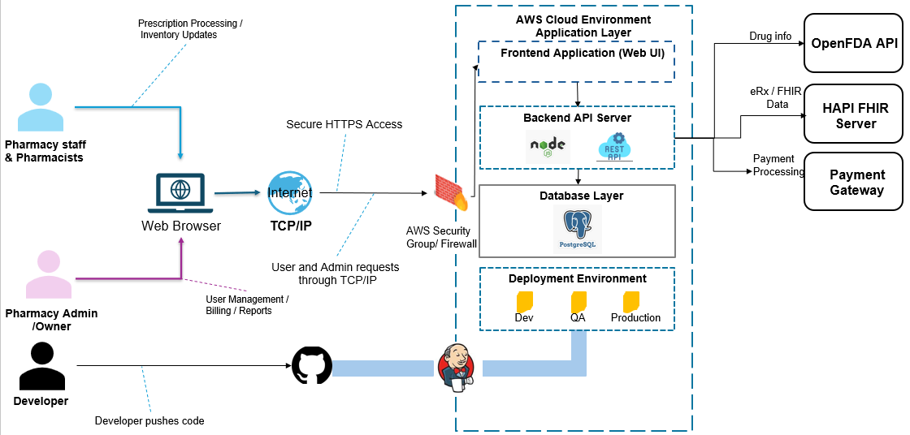
Application: RxFlow
Type: Application Architecture
View: Process View
Style: Client-Server Pattern

